Slide 1
Rut 950 VPN PPTP Server & Client Configuration https://wiki.teltonika.lt/view/VPN
(Bircom – Ergin BOYACI Müşteri Deneyimi ve Ürün Geliştirme)
2018

Slide 2
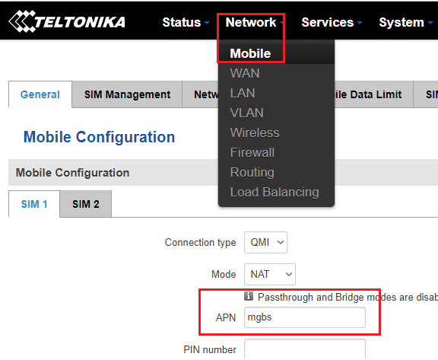

Slide 3
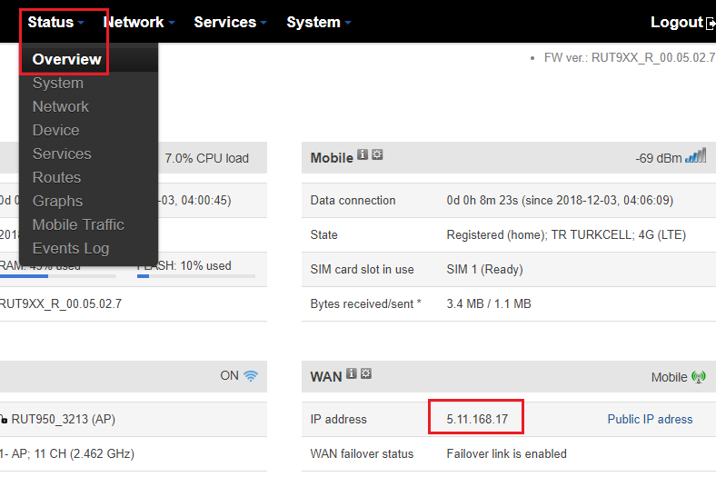

Slide 4
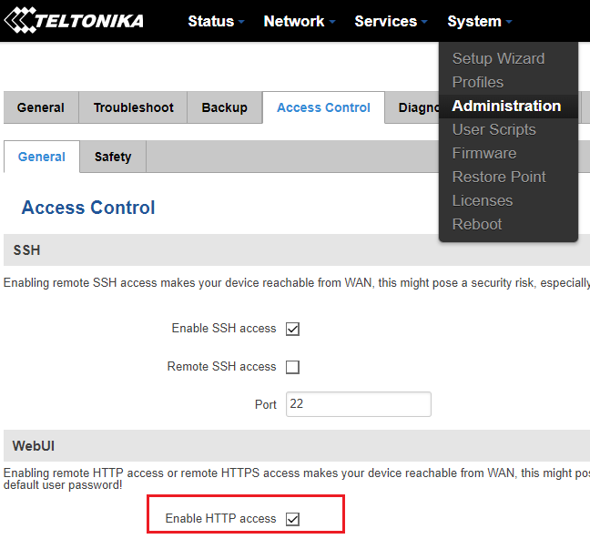

Slide 5
Server
Remote side: WAN IP : 5.26.179.207
LAN Range: 192.168.0.0 / 24
******************************************
Client
Local Side: WAN IP: 5.11.168.17
LAN Range: 192.168.1.0 / 24

Slide 6
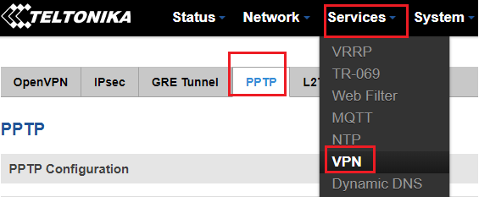

Slide 7
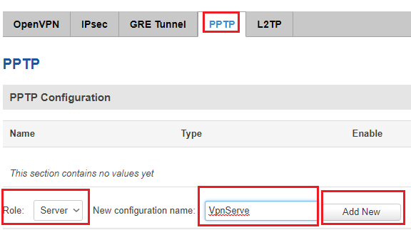

Slide 8
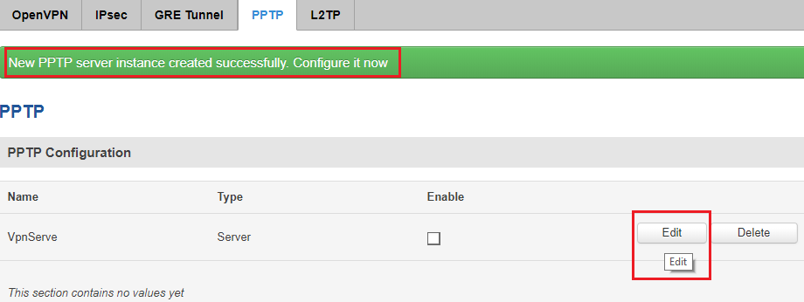

Slide 9
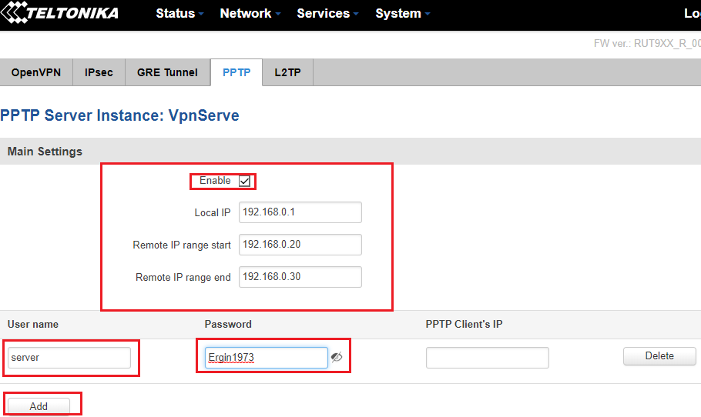

Slide 10
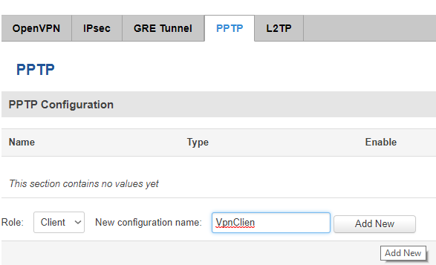

Slide 11
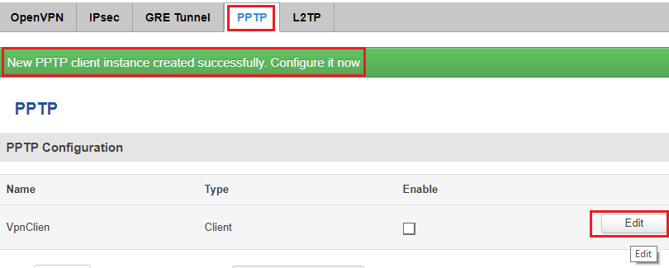

Slide 12
