Slide 1
UCM6xxx IP-PBX Serisi

Slide 2

Şirkete Genel Bakış
UCM6XXX Serisine Giriş
Hızlı Kurulum & Zero Config
UC Özellikleri & Konumlandırma
UCM API & 3. Parti Yazılım Entegrasyonu
Raporlama, Bakım & Sorun Giderme
Güvenlik

Slide 3










Şirkete Genel Bakış
US
Boston - Headquarters
Los Angeles, CA
Dallas, TX
2002 yılında kuruldu
500’den fazla çalışanı var
IP Ses / Video Telefon, Görüntüleme, Ses / Video'nun önde gelen üreticisi
Konferans ve Ağ Çözümleri
Öncelikle küçük-orta büyüklükteki işletmelere (KOBİ'ler) ve tüketici pazarlarına hizmet etmekte
China
Hanghou, Shenzhen
Hong Kong
- Warehouse
Morocco
Casablanca - Support Center, EMEA
Venezuela
Venezuela- Support Center, LATAM
Netherlands
Moerdijk - Warehouse
Malaysia
Kuala Lumpur -Support Center, APAC

Slide 4
Ürün Portföyü
Telephony
IP Voice Telephony
High End, Basic, Mid-Range, Cordless IP Phones
Surveillance
IP Video Telephony
Analog Gateways & ATAs
HD IP Cameras
Network Video Recorders
IP Video Encoders/Decoders
IP PBX Appliances
Video Software Management
Full HD Conferencing System
Audio Conferencing
Wi-Fi Access Points
Networking
Business Conferencing
Multi-WAN VPN Router

Slide 5
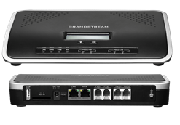
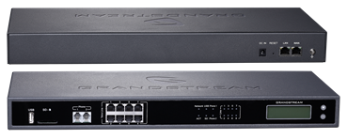
UCM6xxx IP PBX Serisi
Özellikle kobiler ve Kurumsal pazarlar için tasarlanmış uygun fiyatlı, kompakt, sessiz ve kullanımı kolay
Lisans ücreti yok
Hızlı ve kolay kurulum & yönetim
Tüm donanım / yazılım ve ömür boyu yazılım güncellemesi

Slide 6
UCM6XXX Serisi
Ses
Güvenli, yüksek kalite ve güvenilir
Konferans
Tüm kodeklerin desteği
Ses özellikleri özelleştirme
Mobility
Softphone uygulamaları
Uzaktan gözlemleme
Çoklu ofis bağlantısı
Data
Çağrı kayıt
CDR
Kodek transcoding
Sistem yedekleme
Sesli posta/Fax’tan E-posta’ya
LDAP rehber
Video
SIP Video Çağrı
Gözetim Entegrasyonu
Video Kodek Desteği

Slide 7
Hardware Specifications
 | UCM6510 | UCM6200 | UCM6100
İşlemcş | 1GHz quad-core Cortex A9 application | Dual-Core 1GHz | 1GHz ARM Cortex A8
RAM | 1GB DDR3 RAM | 1GB RAM | 512MB RAM
Dahili Hafıza | 32GB Flash | 4GB Flash | 4GB Flash
ISDN port | Entegre 1x E1/T1/J1 port | Entegre | No
FXO port | 2 | UCM6202: 2; UCM6204: 4; UCM6208: 8; | UCM6102: 2; UCM6104: 4; UCM6108: 8; UCM6116: 16
FXS port | 2 | 2 | 2
Ethernet portları | İkili Gigabit RJ45 portu, entegre PoE+ destekli (IEEE 802.3at-2009) |  | Tek (UCM6108, UCM6116) veya Çift (UCM6102, UCM6104) Gigabit RJ45 portu, entegre PoE+ destekli(IEEE 802.3at-2009)
USB ve SD kart girişi | Evet | Evet | Evet
Entegre NAT router | Evet | Evet | Evet (UCM6102 only)
LED göstergeleri ve grafik LCD Ekran | Evet | Evet | Evet

Slide 8
Software Specifications
Specification | UCM6100 | UCM6510 | UCM6200
Kullanıcı | 500’e kadar | 2000‘e kadar | 800’e kadar
Anlık Çağrı | 60’a kadar | 200‘e kadar | 100’e kadar
T1/E1 arayüz | Hayır | Evet | Hayır
NAT Router | Evet (Sadece UCM6102) | Evet | Evet
SIP Trunk | 50‘ye kadar | 50‘ye kadar | 50‘ye kadar
Konferans | UCM6102/6104: 3 köprü, 25 katılımcı UCM6108/6116: 6 köprü, 32 katılımcı | 8 köprü, 64 Eş zamanlı katılımcı | 3 (UCM6202/6204) 25 katılımcıya kadar 6 (UCM6208) 32 eş zamanlı PSTN veya IP katılımcıya kadar
Yedekli Güç Kaynağı | Hayır | Evet | Hayır
FXS ve FXO | FXS: 2, FXO: 2 (6102), 4 (6104), 8 (6108), 16 -6116 | FXS: 2 FXO: 2 | FXS: 2, FXO: 2 (6202), 4 (6204), 8 (6208)

Slide 9

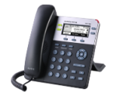
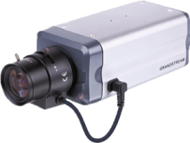
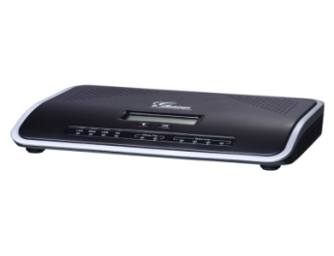
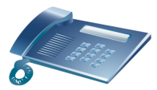



Fax Machine
IP Phone
IP Camera
PSTN
FXO
LAN
Headquarters
UCM
Analog Phone
Router
SIP
Internet
IMS /ITSP
SOHO/HOME
LAN
Router
Service Provider
PC
Fax Machine
Dağıtım Senaryosu
Analog Phone

Slide 10
IP Phone
IP Phone
PSTN
LAN
IP Phone
USA/HQ
Router
Internet
Morocco
Venezula
China
Dağıtım Senaryosu

Slide 11
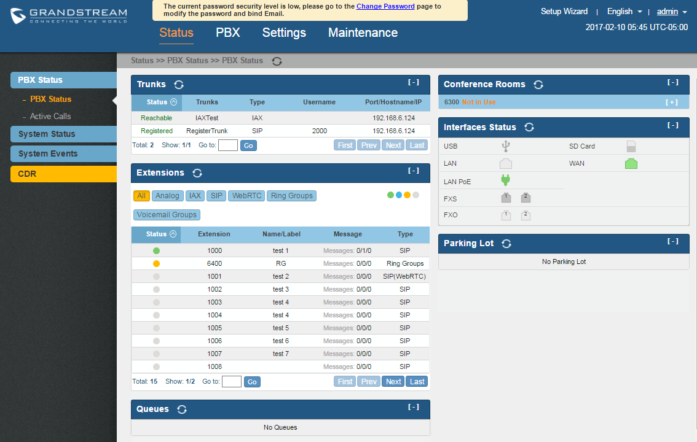
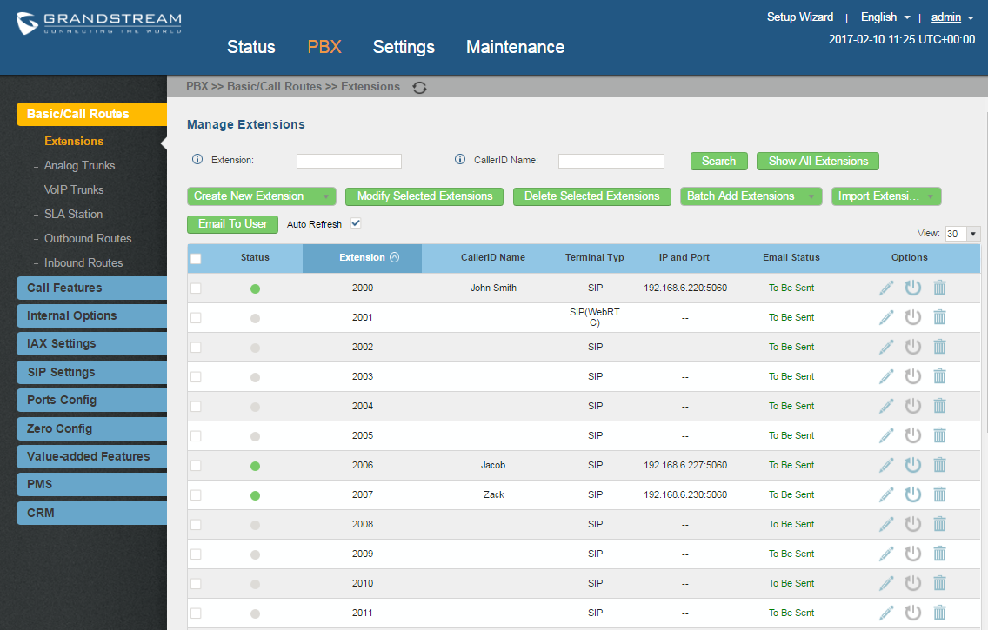
En Kolay Olası Kurulum ...
Notes:
(To appeal to installers) – mention quick and easy setup for customers, remote management for customers, enabling installers to do more

Slide 12
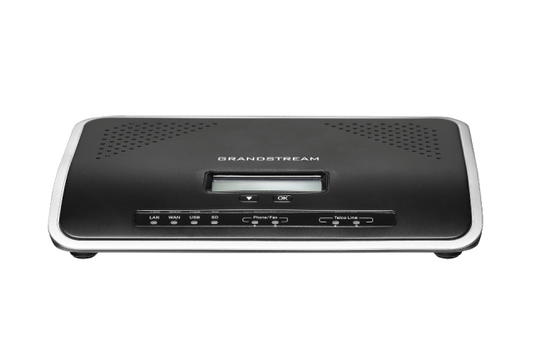
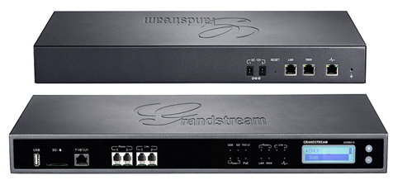
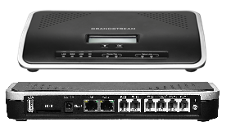
Hızlı Kurulum
Notes:
UCM6102 back view: DC 12V, WAN port, LAN port, 2 x FXO port, 2 x FXS port, SD Card Slot, USB port, Reset, Ground.
UCM6102 front view: LCD, Navigation keys, LED indicators.

Slide 13
Hızlı Kurulum
LCD Menüsünden Erişim Bilgileri Alma
Olayları Görüntüleme: Kritik olayları veya diğer sistem olaylarını görüntüleme
Cihaz Bilgisi: Donanım versiyonu, yazılım versiyonu, P/N numarası, MAC adresi, Çalışma süresi
Ağ Bilgisi: Mod (DHCP, Statik IP, PPPoE), IP adresi, Alt Ağ Maskesi.
Ağ Menüsü: LAN/WAN için ağ ayarları(DHCP, Statik IP, PPPoE).
Fabrika Menüsü: Yeniden başlatma, Sıfırlama, LCD Test Modelleri, Fan Modu, LED Test Modelleri.
Web Bilgisi: HTTP/HTTPS, Port numarası.

Slide 14
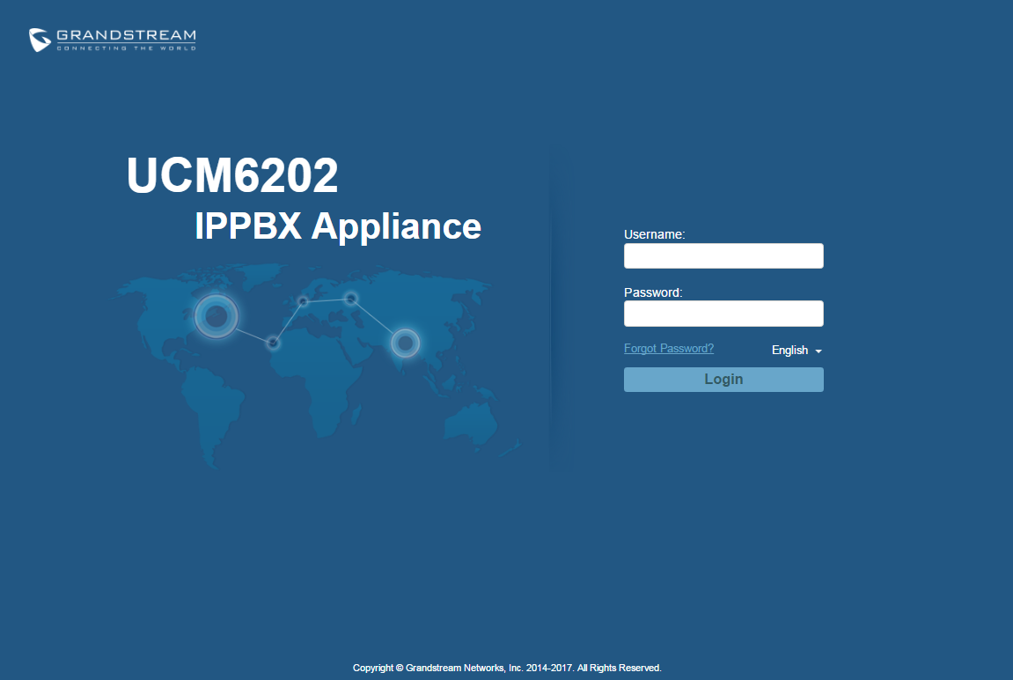
Hızlı Kurulum
Durum ve Yapılandırma için Web Arayüzüne Erişim
Bir bilgisayarı UCM ile aynı ağa bağlayın.
URL'yi aşağıdaki biçimde web tarayıcısına girin :
http(s)://IP-Address:Port
Varsayılan protokol HTTPS .
Varsayılan port numarası 8089.
Örnek: https://192.168.40.167:8089
UCM’in varsayılan LAN IP’si: https://192.168.2.1:8089
Giriş kullanıcı adı ve parolasını girin (varsayılan: admin).
Notes:
- The UCM embedded Web server responds to HTTP/HTTPS GET/POST requests. Embedded HTML pages allow users to configure the device through a Web browser such as Microsoft’s IE, Mozilla Firefox, Google Chrome and etc.
All the configurations on the UCM are done via Web GUI settings. This slide describes how to access the Web GUI. The detailed configurations via Web GUI are described in later sections. Some summary below.
Status: Displays PBX status, System Status and CDR.
PBX: To configure extensions, call routes, call features, internal options, IAX settings and SIP settings.
Settings: To configure network settings, change password, LDAP Server, HTTP Server, Email Settings and Time Settings.
Maintenance: To perform firmware upgrade, backup configurations, cleaner setup, reset/reboot, syslog setup and troubleshooting.

Slide 15
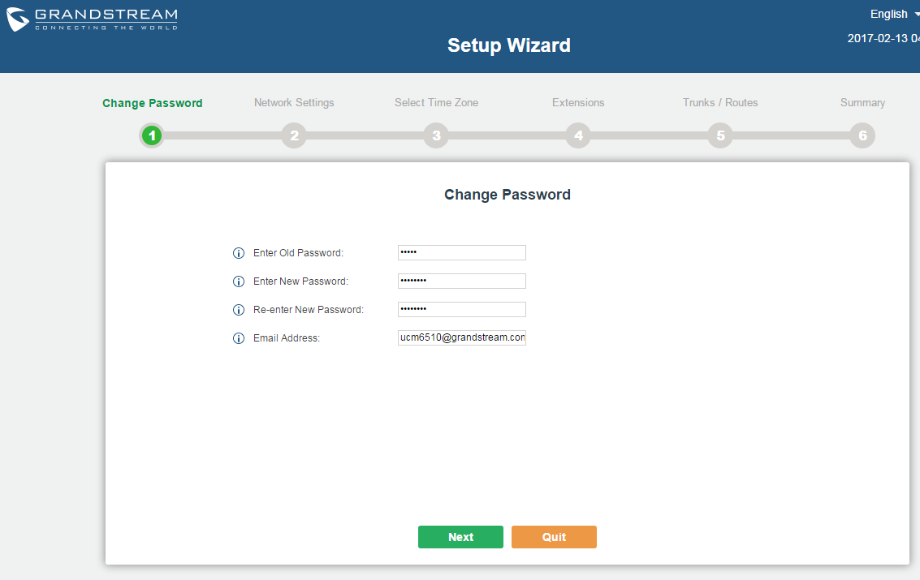
Setup Wizard
UCM6XXX system setup wizard is provided to guide the user to set up basic configurations step by step.
Settings in setup wizard include:
Change password
Network settings
Time zone
Extensions
Trunks and routes
Summary

Slide 16
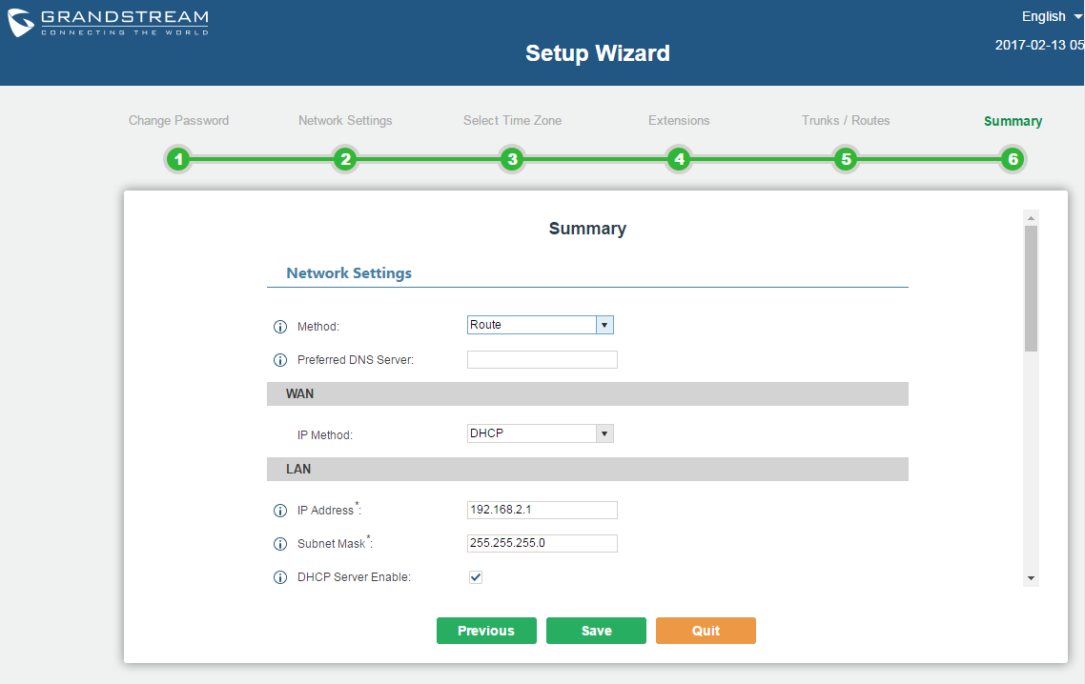
Setup Wizard
The user can always quit the setup wizard at any time to start over with manual configuration
At the last step, the user is provided with summary for review, before the configuration is loaded.
Your system is ready to go!

Slide 17
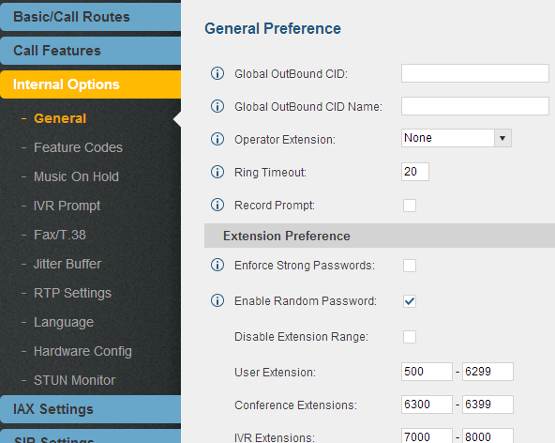
Create User Extensions
Configure Extension Range
PBX > Internal Options > General
Design Considerations
Departmentalize/Segmentation
Plan for Expansion
What to Configure?
User Extensions
Conference Extensions

Slide 18
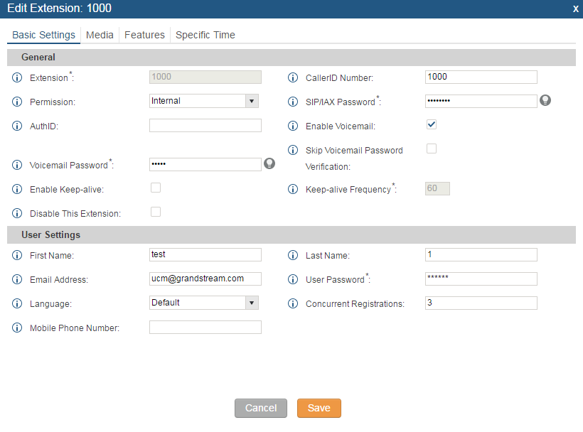
Create User Extensions
Batch & Single User Creation
PBX > Basic/Call Routes > Extensions
Permissions
Strong Password
Voicemail Password
Email Address
SIP/IAX
Strategy
Codecs
Fax Detection

Slide 19
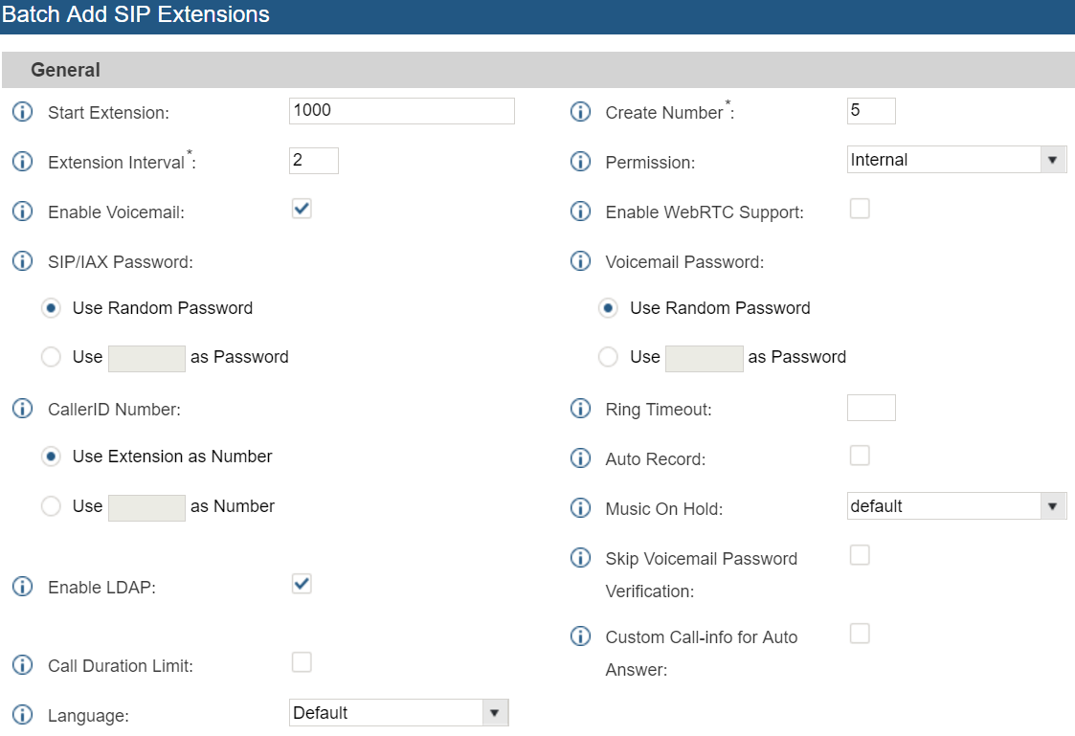
Create User Extensions
Batch Extension Interval
PBX > Basic/Call Routes > Extensions
When adding SIP extensions in batch, users can set the “Extension Interval” as preferred.
For example, if starting extension is 2000 and “Extension Interval” is set to 2, the extensions added in batch are 1000, 1002, 1004...

Slide 20
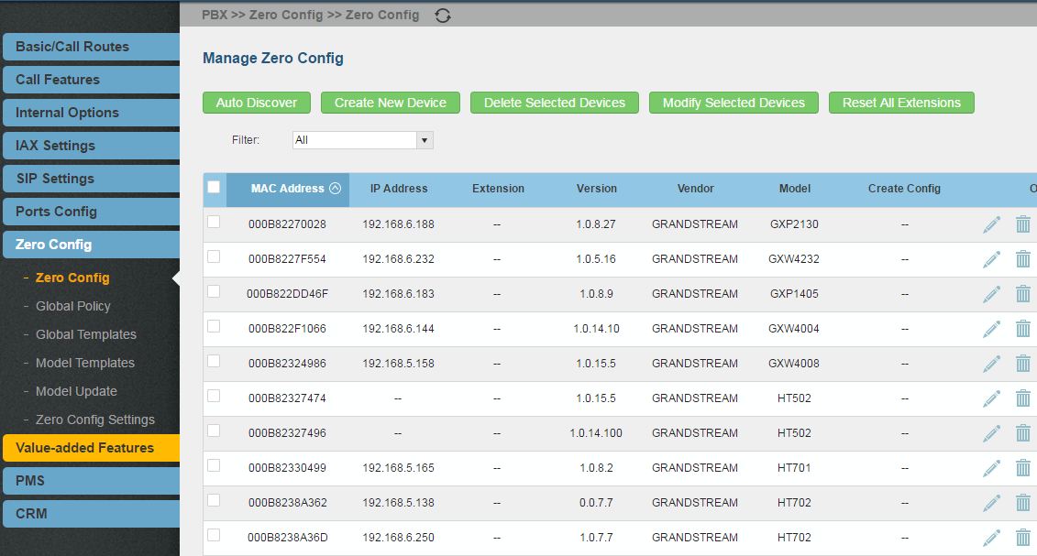
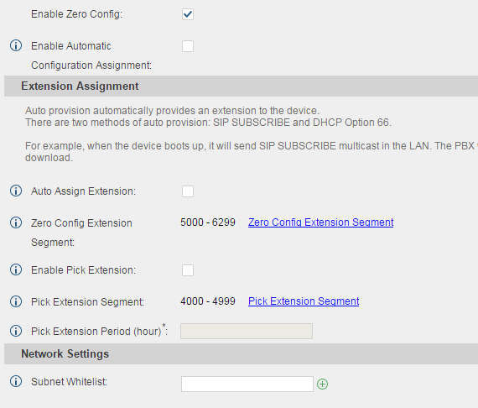
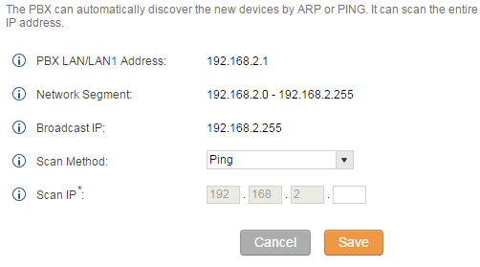
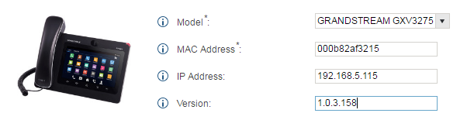
Provisioning using Zero Config
Setup Made EASY!
Plug & Play
Auto Discovery
Automatic Assignment
Minimal Manual Operation

Slide 21
Provisioning using Zero Config
Mechanism
SIP End Device
UCM
UCM6xxx
Boot up
Three methods for the “interaction” between SIP End Device and the UCM:
SIP SUBSCRIBE
mDNS
Option 66 (route mode only)
Discover Device
Assign Extension to Device
Create XML Config File
Download Config File
Send Downloading URL to Device
Reboot, Get Provisioned

Slide 22
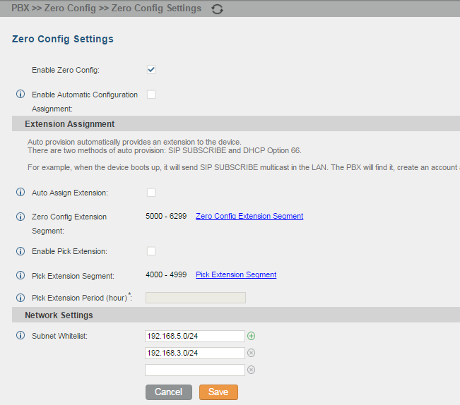
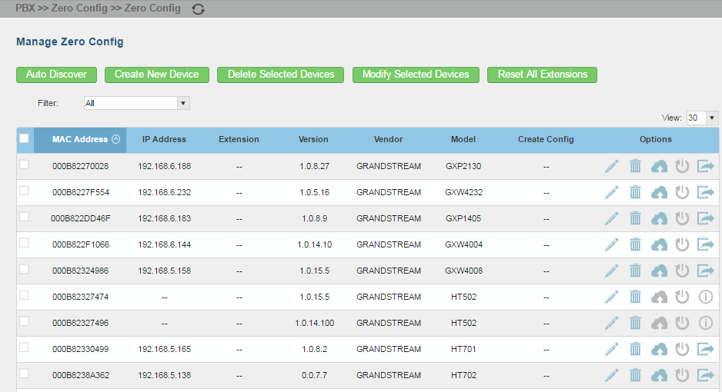
Provisioning using Zero Config
Auto Provisioning Settings
PBX > Zero Config > Zero Config Settings
Notes:
By default, the zero config feature is turned on but the “Automatically Assign Extension” option is turned off. So users will need turn it on for auto provisioning. Otherwise users will need manually assign the extensions to the devices in the discovered device list.

Slide 23
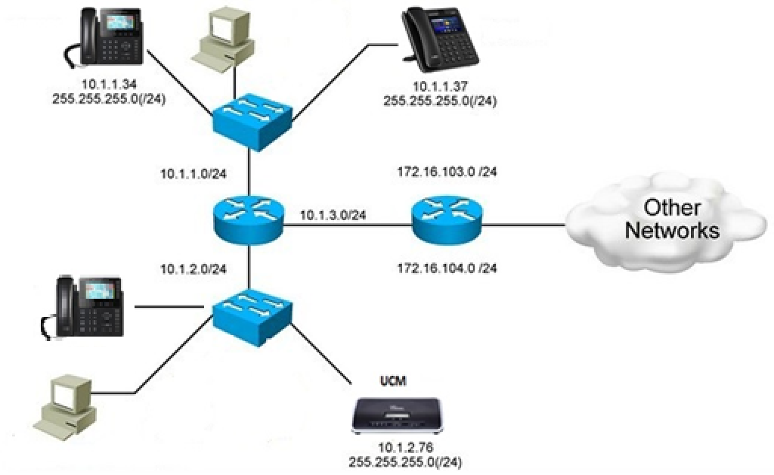
Provisioning using Zero Config
Provision Device from Different Subnets
UCM ZeroConfig can be used to provision end devices deployed in different subnets.
Notes:
By default, the zero config feature is turned on but the “Automatically Assign Extension” option is turned off. So users will need turn it on for auto provisioning. Otherwise users will need manually assign the extensions to the devices in the discovered device list.

Slide 24
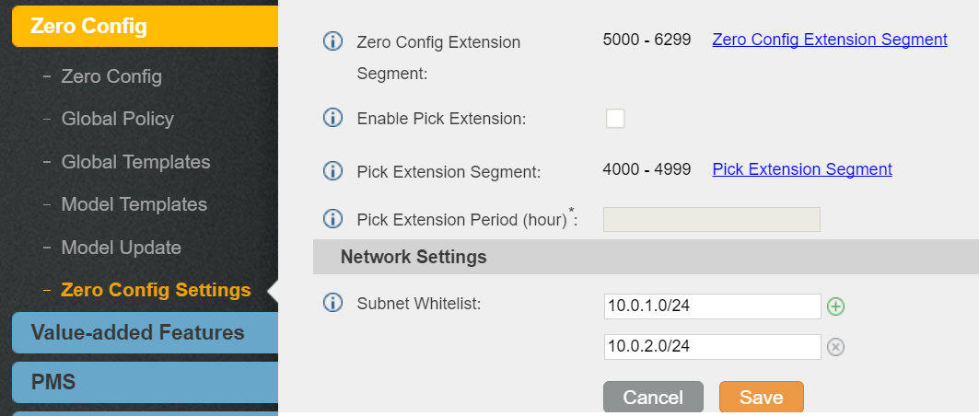
Provisioning using Zero Config
Provision Device from Different Subnets
PBX-> Zero Config->Zero Config Settings->Network Settings-> Subnet Whitelist
The devices in the subnet whitelist ranges can be provisioned via UCM zero config.
Notes:
By default, the zero config feature is turned on but the “Automatically Assign Extension” option is turned off. So users will need turn it on for auto provisioning. Otherwise users will need manually assign the extensions to the devices in the discovered device list.

Slide 25
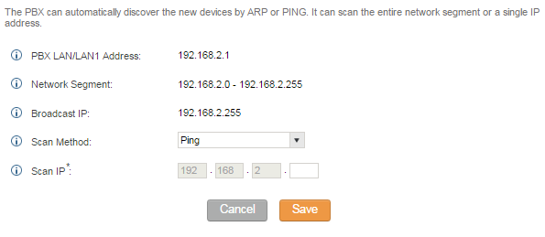
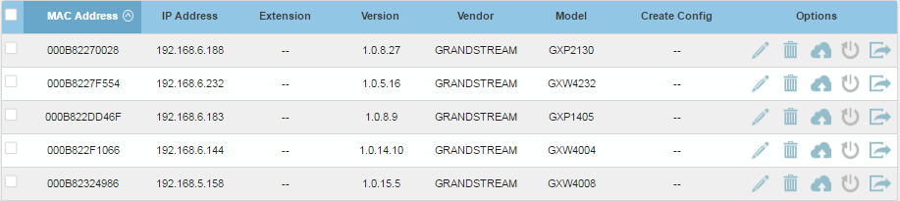
Provisioning using Zero Config
Discovery
PBX > Zero Config > Zero Config
Discovery methods:
PING
ARP
SIP MESSAGE (NOTIFY)
The discovered devices will be displayed in the list.

Slide 26
Provisioning using Zero Config
Global Configuration
Global configuration will apply to all the connected Grandstream SIP end point devices in the same LAN with the UCM no matter what the Grandstream device model it is. It is divided into two levels:
Web UI->PBX->Zero Config->Global Policy
Web UI->PBX->Zero Config->Global Templates.
Global Templates configuration has higher priority to Global Policy configuration, and both will take effect.

Slide 27
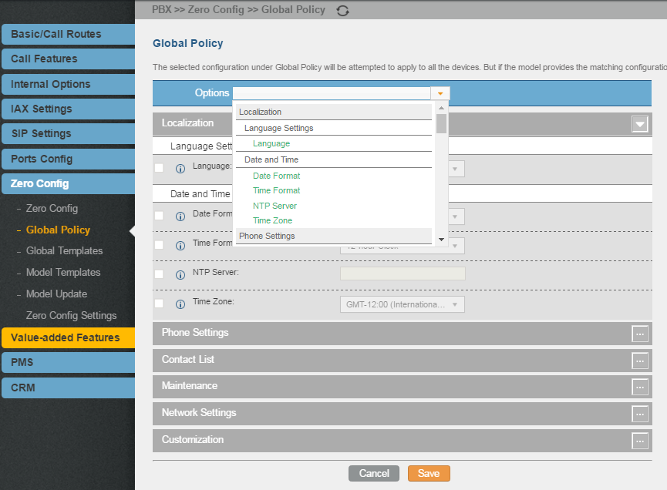
Provisioning using Zero Config
Global Configuration
Global Policy
PBX > Zero Config > Global Policy
Global Policy can be accessed in web GUI->PBX->Zero Config->Global Policy page. On the top of the configuration table, users can select category in the "Options" dropdown list to quickly navigate to the category. The categories are:
Localization: configure display language, date and time.
Contact List: configure LDAP and XML phonebook download.
Maintenance: configure upgrading, web access, Telnet/SSH access and syslog.
Network Settings: configure IP address, QoS and STUN settings.
Customization: customize LCD screen wallpaper for the supported models.

Slide 28
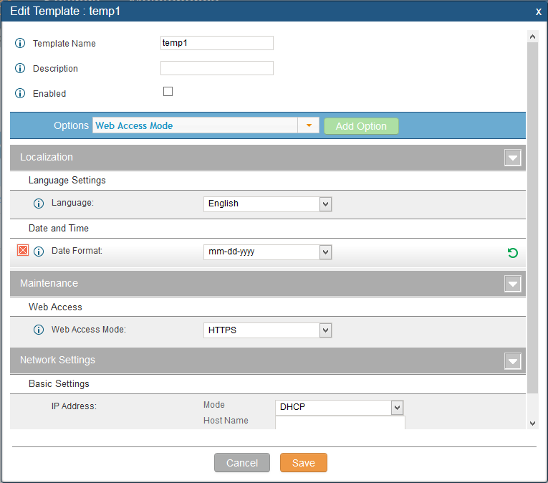
Provisioning using Zero Config
Global Configuration
Global Templates
PBX > Zero Config > Global Templates
Global Templates can be accessed in web GUI->PBX->Zero Config->Global Templates.
Users can create multiple global templates with different sets of configurations and save the templates.
Later on, when the user configures the device in Edit Device dialog->Advanced Settings, the user can select to use one of the global template for the device.

Slide 29
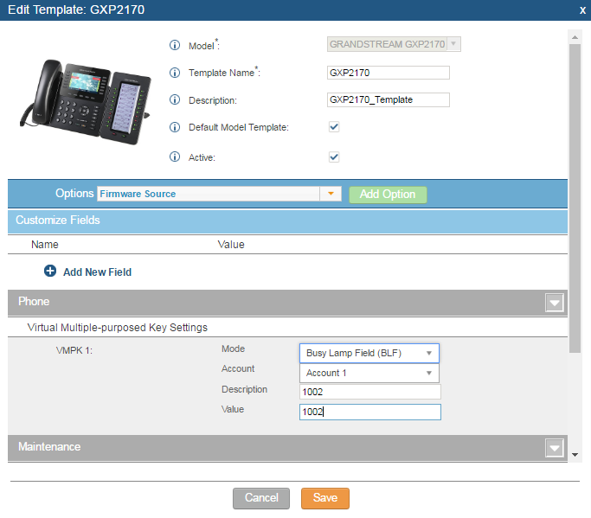
Provisioning using Zero Config
Model Configuration
PBX > Zero Config > Model Templates
Model layer configuration allows users to apply model-specific configurations to different devices.
Users could create/edit/delete a model template by accessing web GUI, page PBX->Zero Config->Model Templates.
If multiple model templates are created and enabled, when the user configures the device in Edit Device dialog->Advanced Settings, the user can select to use one of the model template for the device.

Slide 30
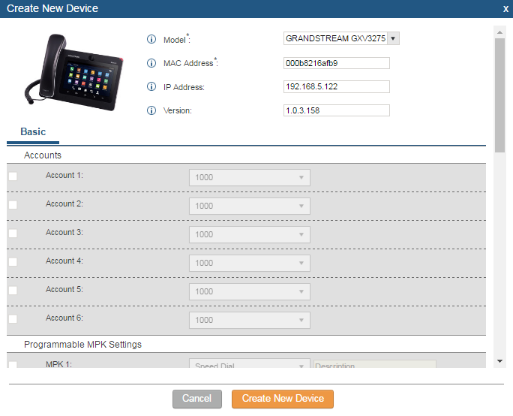
Provisioning using Zero Config
Device Configuration
Create New Device
PBX > Zero Config > Zero Config
Users could directly create a new device and assign basic settings before the device is discovered by the UCM. Once the device is plugged in, it can then be discovered and provisioned by the UCM.

Slide 31
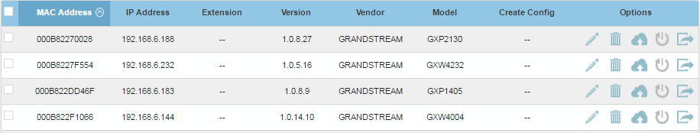
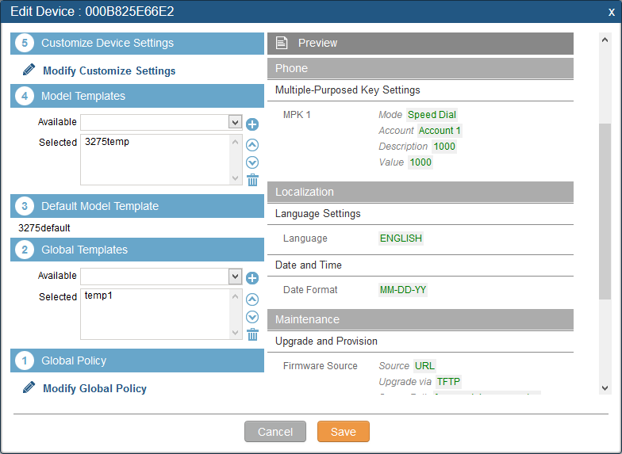
Provisioning using Zero Config
Device Configuration
Manage Devices
PBX > Zero Config > Zero Config
Created or discovered devices will be listed with their MAC address, IP address, vendor, model and some other information.
Users can edit Basic (including multiple accounts) and Advanced Settings of a device.
Users have also the possibility to Customize Device Settings for a specific phone.

Slide 32
Provisioning using Zero Config
Getting Provisioned
After going through the five layer configuration for the device, users could send NOTIFY to the SIP device and trigger it to start auto provision.
Click on to send NOTIFY to the device to trigger it to download the configuration file from the URL contained in the NOTIFY message.
Done!

Slide 33
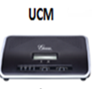
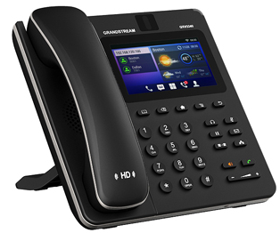

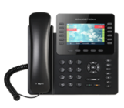
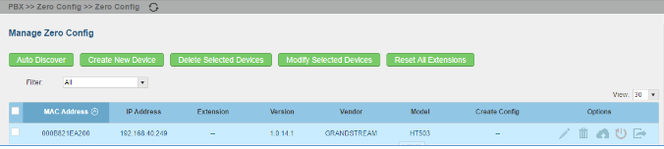
Provisioning using Zero Config
Reboot Remote Device
The UCM6XXX supports rebooting discovered devices from zero config page.
To use this feature, please navigate to web UI-> PBX -> Zero Config -> Zero Config, clicking the reboot button under Options tab.
Reboot

Slide 34

Provisioning using Zero Config
Integration with GSWave QR CODE SCAN
GSWave is a Grandstream softphone application for Android devices on Android 4.0 and higher. It can be automatically provisioned by the UCM using QR code scan.
Steps:
Go to UCM web UI->PBX->Basic/Call Routes->Extensions. Click on
2. The UCM users that have Email address configured in the extensions will receive account registration and LDAP configuration information in Email.
3. On GSWave app, select “UCM Account (QR_code Scan) to scan and get registered immediately.

Slide 35
Company Overview
Introduction to UCM6XXX series
Quick Setup & Zero Config
UC Features & Positioning
UCM API & 3rd party integration
Reporting, Maintenance & Troubleshooting
Security
Live Demo
Certification Exam

Slide 36



UC Features & Positioning
Multiple Registration per Extension
UCM supports multiple registration per extension. The user can register from multiple devices to UCM using a single account.
GS Wave: Extension 1000
Register
Register
Home Phone: Extension 1000
Register
Office Desk Phone: Extension 1000

Slide 37
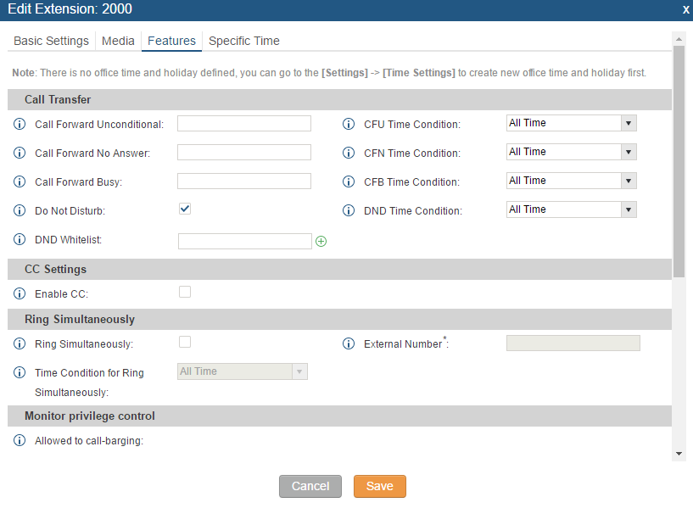
UC Features & Positioning
DND Whitelist
PBX->Extensions-> Create a New Extension/Edit Extension->Feature->Do Not Disturb->DND Whitelist
In UCM extension settings, the user can enable DND and then add numbers in DND Whitelist. When “Do Not Disturb” is turned on in UCM extension settings, the calls from DND Whitelist can still be accepted by the extension.
Up to 10 numbers can be added in DND Whitelist.

Slide 38

UC Features & Positioning
Seamless Transfer
Seamless Transfer allows user to perform blind transfer using UCM feature code without having music on hold presented during transfer process.
Seamless transfer minimizes the interruption during transfer, making the process smooth and simple.
Seamless transfer mode:
  Seamless transfer
  Pickup incall
  Mobile Phone Pickup

Slide 39
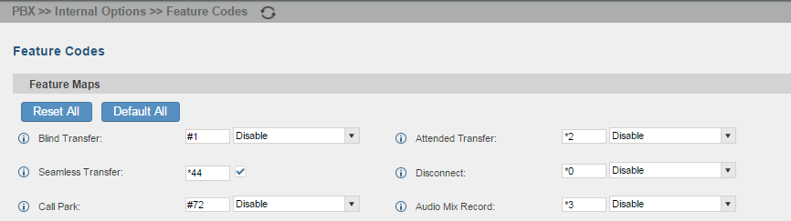



UC Features & Positioning
Seamless Transfer
To perform Seamless Transfer:
Enable seamless transfer on the UCM WebUI->PBX-> Internal Option-> Feature Codes.
B calls A and establishes call.
A dials seamless transfer feature code followed by the number to transfer to.
The call will be transferred.
Phone B
Phone A
Phone B

Slide 40
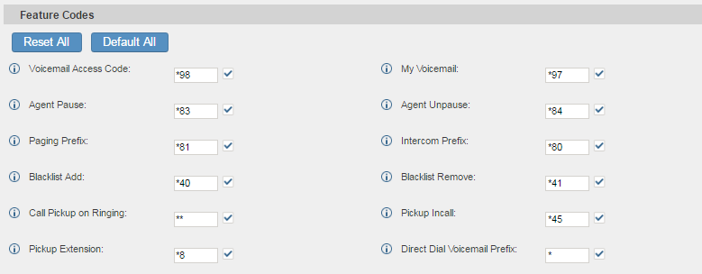
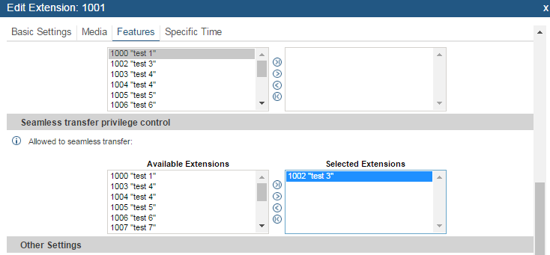

UC Features & Positioning
Seamless Transfer
Pickup incall
To perform pickup incall:
Enable Pickup incall from UCM WebUI->PBX->Internal Options->Feature Codes.
Add extension A to the Selected extension for seamless transfer on extension B
B and C establish call.
A dials the pickup incall feature code followed by B’s extension.
B will be disconnected and A will be connected to C.
X
Phone C
Phone B
Phone B
Phone C
Phone A

Slide 41
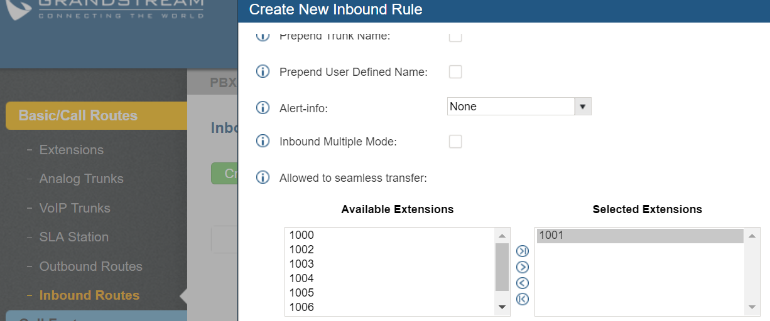
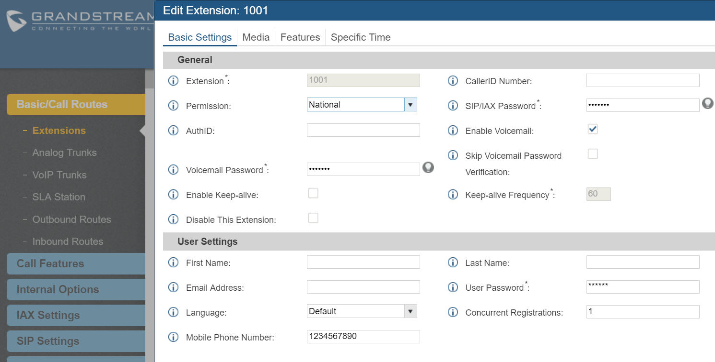
UC Features & Positioning
Seamless Transfer
Mobile Phone Pickup
To seamless pick up B’s existing call from mobile phone:
On B’s extension setting->Basic Settings, configure “Mobile Phone Number”.
2. In the inbound route for the trunk that mobile phone will come in, add extension B to the “Allowed to seamless transfer” list.
3. Establish call between A and B.

Slide 42




UC Features & Positioning
Seamless Transfer
Mobile Phone Pickup
A
Extension B on desk phone
4. From your mobile phone, call into the UCM from the trunk.
5. Once the call is established, the call is automatically transferred to mobile phone.
6. Extension B will hang up.
A
Extension B on desk phone
Call into trunk using extension B’s associated mobile phone number
A
B’s mobile number associated with extension B
B’s mobile number associated with extension B
B’s extension on desk phone
Extension A

Slide 43
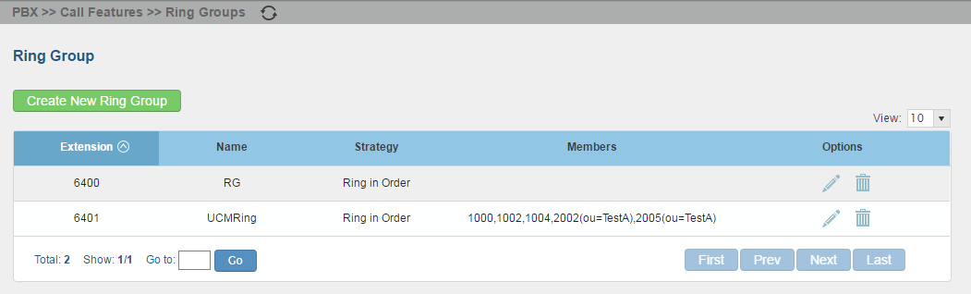
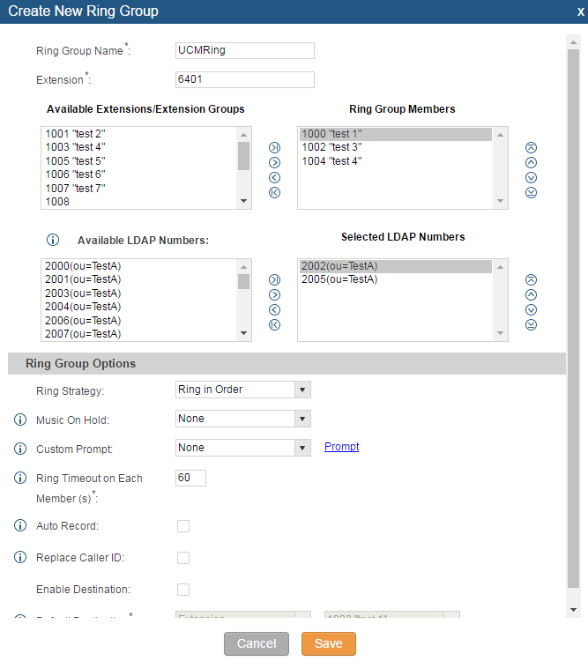
UC Features & Positioning
Ring Group
PBX > Call Features > Ring Groups
10 Ring Groups
Up to 100 members per Group
Parallel or Serial ringing mode
Custom Prompt
Auto record
Default Destination

Slide 44
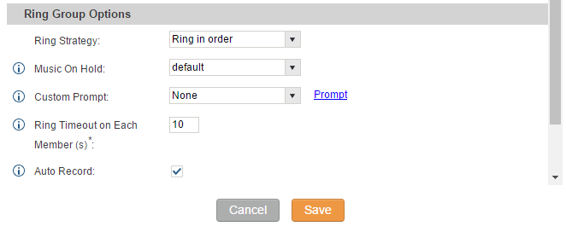
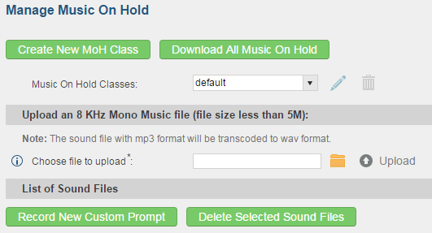
UC Features & Positioning
Ring Group
PBX > Call Features > Ring Groups
The UCM6XXX supports music on hold for ring group. Users can upload sound file for specific ring group.
Please navigate to web UI-> PBX-> Call Features-> Ring Group-> Create New Ring Group/Edit, from the drop down menu, select the hold music from music on hold class to play for the ring group.

Slide 45
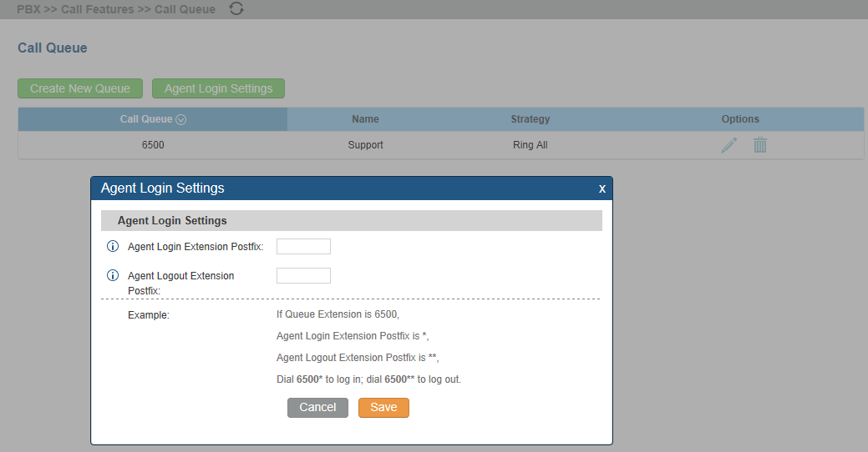
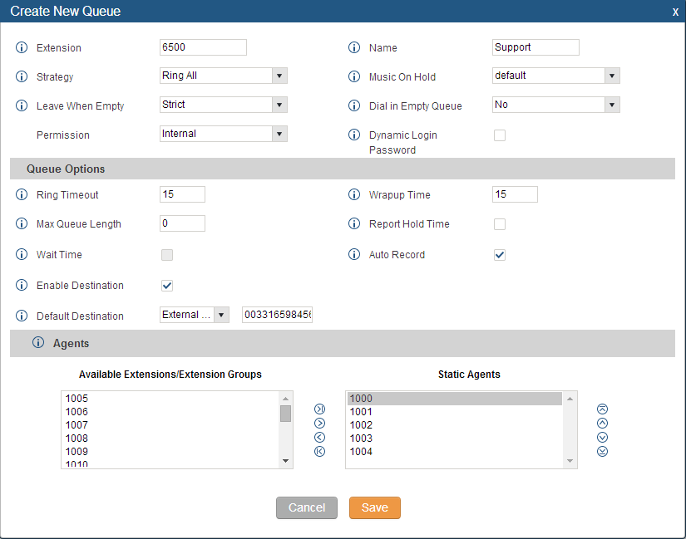
UC Features & Positioning
Call Queue
PBX > Call Features > Call Queue
10 Call Queues
Up to 100 agents per Queue
Parallel, Serial, Last recent, Fewest Calls, Random, Round Robin ringing modes
Custom Music On Hold
Auto record
Default Destination

Slide 46
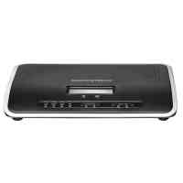
UC Features & Positioning
Ring Group/Call Queue/IVR Display Option for Caller ID
If “Replace Caller ID” is enabled for Ring Group, Call Queue or IVR, when phone A calls in ring group, call queue or IVR to reach phone B, A’s caller ID will be replaced with the Ring Group, Call Queue or IVR name.
This allows the callee to see whether the call is from the extension directly, or dialed from Ring Group, Call Queue or IVR.
IVR
Ring Group
Call Queue

Slide 47



UC Features & Positioning
Conference Bridge
PBX > Call Features > Conference
Bridging the Gap
Public or Private
Recording Option
Bridging of Multiple Parties
Caller Menu
User Invite
Caller Announcements

Slide 48








UC Features & Positioning
Multiple Conference Bridges
PBX > Call Features > Conference
UCM A and UCM B are interconnected via SIP peer trunk. On the UCM A’s web UI, the administrator can directly invite a conference room on the UCM B to connect to UCM A’s conference room, essentially bridging two conference rooms together.
UCM6202 A
SIP Peer Trunk
UCM6202 B
Conference Room A
Conference Room B

Slide 49

UC Features & Positioning
Conference Scheduling
After the user enables Google Calendar setting under Google Service Support, Conference Scheduling can synchronize with Google Calendar for authorized Google account.
Conference Scheduling feature can be found under web UI-> PBX-> Call Features-> Conference Schedule

Slide 50


UC Features & Positioning
Conference Scheduling
Click on to reserve the conference room.
Once kick time is reached, all users will be removed from the conference room
If Google Calendar is enabled under Google Service Settings, Scheduled Conference can synchronize with Google Account
Select extension that can access the conference room at scheduled time, other extensions won’t be able to use the conference room at that time

Slide 51


UC Features & Positioning
Conference Scheduling
Once the conference room is scheduled, at the kick time, all user will be removed from the conference room and no other extension is allowed to join the conference room at that time.
At the conference time, UCM will send INVITE to the extensions that have been selected. Please note for remote extensions, user needs to make sure that outbound rule is properly configured to reach them.
Please note that once kick time is reached, Conference schedule is locked and can’t be modified.
Conference room is scheduled
Selected Extension
Selected Extension
Unselected Extension

Slide 52



UC Features & Positioning
Voicemail to Email
Not in the office?
Voicemail to Email
Configure Voicemail Limits
Playback Options

Slide 53


UC Features & Positioning
Fax to Email
No Fax Machine? No Problem!
Fax Extension
Fax Settings
Fax to Email Template

Slide 54


UC Features & Positioning
VFax File Management (Display/Download/Delete) via Web UI
UCM administrator can view, download and delete received VFax file in web UI.
Benefits
An administrator can examine and retrieve the received VFax file.
An administrator can manually select and delete the obsolete VFax files in the UCM system to manage internal storage space.

Slide 55

UC Features & Positioning
Pickup Groups
PBX > Call Features > Pickup Groups
The UCM supports pickup group feature which allows users to pick up incoming calls for other extensions if they are in the same pickup group, by dialing "Pickup Extension" feature code (by default *8).

Slide 56

UC Features & Positioning
Call Barge
Offers ability to listen in on agents calls, whisper to the agent and barge in on both calling parties.
Integrated with active call status under web UI->Status->Active Calls page.
Active Calls feature supported on firmware 1.0.7.11 already.
Click on “Monitor” icon for call barge feature

Slide 57



UC Features & Positioning
Call Barge: Spy Mode
  Listen
  In “Listen” mode, monitor’s extension can hear both parties in the active call but monitor’s audio won’t be heard by either side of the monitored active call.
  Whisper
  In “Whisper” mode, monitor’s extension can hear both parties in the active call but monitor’s audio can only be heard by the monitored extension.
  Barge
  In “Barge” mode, monitor’s extension can talk to both parties in the active call. The call will be established similar to a three-way conference.

Slide 58

UC Features & Positioning
Extension-based Privilege Control
PBX->Extensions->Create or Edit Extension->Features->Monitor privilege control
UCM supports call-barging privilege settings based on extensions. Only the extensions added in the “Allowed to call-barging” list can barge in active calls.
For example, in extension 1001’s setting, select 1002 and 1003 from Available Extensions to Selected Extensions on the right. When 1001 is in active call, only extension 1002 and 1003 can barge in using feature code.

Slide 59

UC Features & Positioning
Intercom & Paging
PBX > Call Features > Paging/Intercom
Flexible members selection
1 way paging
2-way Intercom
Custom Prompt

Slide 60
UC Features & Positioning
Distinctive Ring Tone
The UCM6XXX supports distinctive ring tone when an inbound call is coming from call queue, IVR, inbound route or extension.
Users can configure the “alert-info” filed to select different ring tone for an specific incoming call.
Call Queue
RingTone1
IVR
RingTone2
Inbound Route
RingTone3
Extension
RingTone4

Slide 61


UC Features & Positioning
Custom Call-Info for Auto Answer
PBX->Extensions->Edit Extension->Features->Other Settings ->Custom Call-info for Auto Answer
Custom Call-Info for Auto Answer in UCM extension settings
Users need enable auto answer by call-info on the end device.
Call settings on Phone (e.g., GXP phone):
Enable “Allow Auto Answer by Call-Info”

Slide 62

UC Features & Positioning
Custom Call-Info for Auto Answer
In UCM extension settings, users can enable “Custom Call-Info for Auto Answer” for this extension.
When a call is sent to this extension from UCM, the SIP INVITE message will contain a Call-info
header indicating auto answer.
If the end device registered with this extensions has “Enable Auto Answer by Call-Info” enabled, this call will be automatically answered.
SIP INVITE with Call-info header: answer-after=0
Dialing 1002
UCM
Extension 1002

Slide 63

UC Features & Positioning
Follow Me
PBX > Call Features > Follow Me
Follow Me is a feature on the UCM that allows users to direct calls to a single or multiple phone numbers and have them ring all at once or one after the other. Calls can be directed to users’ home, office, mobile or any phone worldwide. The calls will get to users no matter where they are.

Slide 64

UC Features & Positioning
Call Completion (Busy Camp-on)
The extension might not be available (busy, away or call rejected) when another extension is trying to reach it.
Call completion/busy camp-on can help.
PBX can camp on the called party and inform the caller as soon as the called party becomes available.
Supported on individual extension. For example, when Extension A calls Extension B, call completion can be requested.
Supported on SIP Trunks. For example, when Extension A on UCM A calls Extension B on UCM B, call completion can be requested.

Slide 65

UC Features & Positioning
Call Completion: How to determine “Available”
The UCM will initiate callback when the previously unavailable extension becomes available. It uses the following conditions to detect if the extension is available or not:
If extension B was busy when being called, extension B is considered as available after the previously active call hangs up.
If extension B rejected the call or the call went to timeout when being called, extension B is considered as available after a new call is completed. This means extension B has to initiate a new call or answer another incoming call. When the new call hangs up, extension B is considered as available.

Slide 66



UC Features & Positioning
Analog Trunks
Utilizing Existing Systems
Ability to Select Individual Channels
Auto Detection
Custom Tone Settings
Auto Record
Fax Detection
SLA mode

Slide 67
UC Features & Positioning
SLA (Shared Line Appearance)
The basic function of SLA is to map the key with LED on a multiple-line phone to different external lines. Therefore, when there is an incoming call, all the phones will start to ring and the LED for the corresponding line will flash in red for the user to pick up from any phone. By using the LED for the line key on the multiple-line phone, we can also clearly see the status of the external line to learn whether it’s occupied or not. From this point of view, SLA is very similar to BLF, except BLF is monitoring internal extensions while SLA is monitoring external lines
Hold Access (Open/Private):
Open: If set to Open, any trunk put on Hold by the SLA station can be picked by any SLA station monitoring this trunk.
Private: If set to private, any trunk put on Hold by the SLA station can be picked only back up from this station.

Slide 68



UC Features & Positioning
VoIP Trunks
SIP/VoIP Trunking
Peered or Registered
Auto Record
Multi-DODs support
Long-Distance Charges Reduced

Slide 69


UC Features & Positioning
Call Routing
Outbound Rule: How can I direct your call?
Dial Pattern
Secured Route
Strip/Prepend Digits
Failover
Privilege/Permission
Outbound route per Source caller ID
Call Duration Limit

Slide 70
UC Features & Positioning
Call Routing
How to Use Outbound Route Pattern
Pattern: It is similar to dial plan.
All patterns are prefixed by the “_” character.
N = Any digit from 2-9
. = Wildcard, matches one or more characters
! = Wildcard, matches zero or more characters immediately
X = Any Digit from 0-9
Z = Any Digit from 1-9

Slide 71
UC Features & Positioning
Call Routing
How to Manage Outbound Route
Privilege Level: There are 4 different types:
  DISABLED: Only the selected extensions or extension groups are allowed to use this rule, it should be used wit the filter on source caller ID option.
  INTERNAL: the lowest level which can be accessed by anybody.
  LOCAL: users who have local, national and international level are allowed to use this.
  NATIONAL: users who have national and international level are allowed to use it.
  INTERNATIONAL: the highest level which can only be accessed by users with international permission.
Password
Create password for users to enter before they can use this rule to make outbound calls.

Slide 72


UC Features & Positioning
Call Routing
How to Filter users allowed to use Outbound Route
Allow only Specific users to use specific outbound routes
Allow group of extensions to use specific outbound routes

Slide 73



UC Features & Positioning
Call Routing
Outbound Route: PIN Group
The UCM6XXX supports PIN Groups. Once PIN Groups feature is configured, users can apply PIN Groups to a specific outbound routes.
When placing a call on pin protected outbound route, caller will be asked to input the group pin number.
Group 1
PIN Group 1
PIN Group 2
Group 2

Slide 74



UC Features & Positioning
Call Routing
Outbound Route: PIN Group
PIN Groups feature can be found under PBX-> Internal Options-> PIN Groups.
If “Record In CDR” option is enabled, the CDR record will display PIN Groups information accordingly.
Please note: if PIN Groups feature is enabled on outbound route level, “Password”, “Privilege Level” and “Enable Filter on Source Caller ID” will be disabled.

Slide 75


UC Features & Positioning
Call Routing
Outbound Route: Outbound blacklist
The UCM6XXX now allows users to put country code restrictions on specific outbound routes.
Once the restriction is enabled, call to the restricted country cannot be placed on that specific trunk.
To configure this feature, please navigate to web UI-> PBX -> Basic -> Outbound Routes -> Country Codes.

Slide 76
UC Features & Positioning
Call Routing
Outbound Route: Time Condition
UCM now supports time condition for outbound route. Users could customize holiday time, office time or a specified time to allow the outbound route to be used.
 | Mon | Tue | Wed | Thu | Fri | Sat | Sun
8:00AM - 5:00PM | Outbound Route 1
5:00PM - 8:00AM | Outbound Route 2
All Day |  |  |  |  |  | Outbound Route 3
Outbound Route 1
Outbound Route 2
Outbound Route 3

Slide 77

UC Features & Positioning
Call Routing
Append Extension Number in DOD
Unique DOD per extension
In UCM WebUI->PBX->Basic/Call Routes->VoIP Trunks->DOD, users can enable “Add Extension” so that the selected extension number will be appended to the DOD.

Slide 78



UC Features & Positioning
Call Routing
Append Extension Number in DOD
For example, assuming DOD number is 1234 and the selected extensions are 1000, 1001 and 1002, if “Add Extension” is enabled, the actual DODs shown in outbound call are 12341000, 12341001 and 12341002.
1000
12341000
VOIP Trunk
12341001
1001
12341002
1002

Slide 79


UC Features & Positioning
Call Routing
Inbound Rule:
How can I direct your call?
DID Pattern
Trunk Selection
Direct Calls to IVR, Extension, Ring group, Voicemail, FAX
Scheduled Inbound Routes
Inbound route per caller ID

Slide 80


UC Features & Positioning
Call Routing
Inbound Route Features
DID Features
Manage the destinations the inbound
route can reach when “By DID” is selected.
Blacklist
Block callers for all inbound routes.

Slide 81

UC Features & Positioning
Call Routing
Inbound Route – Multiple Mode
This option can be found under web UI->PBX->Basic/Call Routes->Inbound Routes.

Slide 82
UC Features & Positioning
Call Routing
Inbound Route – Multiple Mode
When Multiple Mode is enabled for the inbound route, the user can configure a “Default Destination” and a “Mode 1” destination for this route. By default, the call coming into this inbound route will be routed to the default destination.
From a SIP end device that has UCM extension registered, dial feature code *62 will switch the inbound route destination to “Mode 1”; dial feature code *61 will switch the inbound route destination to “Default Destination”. This can be easily configured without web UI admin login.
For example, the customer service hotline destination has to be set to a different IVR after 7PM. The user can dial *62 to switch to “Mode 1” with that IVR set as the destination before off work.

Slide 83


UC Features & Positioning
Call Routing
Enable/Disable Inbound and Outbound Route
After creating inbound/outbound route, users can choose to enable and disable it.
If the route is disabled, it will not take effect anymore. However, the route settings will remain in UCM.
Users can enable it again when it’s needed.

Slide 84



UC Features & Positioning
Auto-Attendant (IVR)
No receptionist?
Record or Upload Custom Voice Prompts (5MB)
Supports Multiple Languages
Scheduled Routes to Specific IVR Prompts e.g. Afterhours, Holidays, Maintenance
Nested IVRs up to 5 levels

Slide 85

UC Features & Positioning
Auto-Attendant (IVR)
Key Pressing Events
Available options for Key Pressing Events:
Extension
Voicemail
Conference Rooms
Voicemail Group
IVR
Ring Group
Queues
Page Group
Fax
Custom Prompt
Hang-up
DISA
Dial By Name
External Number
Callback

Slide 86

UC Features & Positioning
Auto-Attendant (IVR)
Whitelist/Blacklist for IVR Dialing
Whitelist/Blacklist for calls dialed from IVR can restrict the caller from reaching certain extensions or external numbers via IVR.
For example:
  The company CEO and directors prefer only receiving the call transferred by the secretary only.
  Some extensions are used on IP surveillance end points which shouldn’t be reached from external calls via IVR for privacy reason.
* External numbers can be configured for blacklist/whitelist only when “Dial Trunk” is enabled for IVR.

Slide 87





UC Features & Positioning
Auto-Attendant (IVR)
Whitelist/Blacklist for IVR Dialing
Blacklist:
The extensions in the blacklist will not be allowed to be reached via IVR.
Whitelist:
Only the extensions in the whitelist can be reached via IVR.
IVR

Slide 88


UC Features & Positioning
Auto-Attendant (IVR)
Whitelist/Blacklist for IVR Dialing
Configurations:
1. Log in UCM web UI. Navigate to PBX->Call Features->IVR to create or edit an IVR.
2. Under “Basic Settings” tab, configure option “IVR Black/White List” to enable Blacklist or Whitelist.
3. Select the extension to be included in blacklist or whitelist.
4. If “Dial Trunk” is enabled, configure external number for blacklist or whitelist.

Slide 89

UC Features & Positioning
DISA (Direct Inward System Access)
PBX > Call Features > DISA
The UCM supports DISA to be used in IVR or inbound route to allow dial out. Before using it, create new DISA under web GUI->Call Features->DISA
Once successfully created, users can configure the inbound route destination as "DISA" or IVR key event as "DISA". When dialing into DISA, users will be prompted with password first. After entering the correct password, a second dial tone will be heard for the users to dial out.

Slide 90







UC Features & Positioning
Callback Feature
Callback feature on UCM is mainly designed for users who often use their mobile phones to make long distance or international calls which may have high service charges.
1
An economic solution for reducing the cost while enjoying the mobility.
6
Firstly, dial the PSTN number of the UCM from your cell phone.
Enjoy!
5
2
4
3
Dial your destination number.
Hang up when you hear the ringback tone.
A few seconds later, UCM calls back and your cell phone rings.
Pick up the call. The call will then be immediately directed to DISA or IVR in the UCM.

Slide 91



UC Features & Positioning
Mobile Phone Number for Extension
On phone A, dial the feature code *88 followed by phone B’s extension number 1002. The configured mobile phone number for the extension will start ringing.
Ringing
Dial *881002
UCM
Mobile number configured
Phone A
Extension 1002
Phone B

Slide 92

UC Features & Positioning
Mobile Phone Number for Extension
PBX->Basic-> Extensions->Create a New Extension/Edit Extension->Basic Setting->Mobile Phone Number
The UCM supports binding a mobile phone number to extension. The user can dial a feature code + extension to directly dial the mobile phone number.
Configurations:
In UCM webUI->PBX->Basic-> Extensions->Create a New Extension /Edit Extension->Basic Setting->Mobile Phone Number, enter the mobile number.
In UCM webUI->PBX->Internal Options->Feature Codes, enable “Direct Dial Mobile Phone Prefix”.

Slide 93



UC Features & Positioning
Hotline Support
PBX > Basic/Call Routes>Extensions>Create New FXS Extension/Modify FXS Extension>Features>Hotline
Hotline feature on UCM supports two mode for FXS extension:
Hotline Immediate mode:
After FXS extension is offhook, the hotline number will be dialed out right away.
Hotline Delay mode:
After FXS extension is offhook, the UCM will wait for 5 seconds and then dial the Hotline number.
Delay Mode
FXS extension is offhook
Immediate Mode

Slide 94

UC Features & Positioning
Wakeup Service
Wakeup service is available on UCM as a separate module (without other interface-generalized solution)
There are three ways to set up Wakeup Service:
Using admin login
Using user portal
Using feature code

Slide 95


UC Features & Positioning
Wakeup Service
Wakeup Service configuration is under UCM WebUI->PBX->Call Features->Wakeup Service.
Enable wakeup service, configure name, extension, prompt, date and time to receive the wakeup call.

Slide 96


UC Features & Positioning
SMS Message
SIP end devices that supports SMS message can send and receive SMS message.
Asterisk 1.8
SMS
Asterisk 1.8
Asterisk 13
Asterisk 13

Slide 97

UC Features & Positioning
Announcement Center
Announcement center allows user to pre-record and store voice prompts in UCM with a code associated to it. The user also needs to create group with extensions assigned.
When code and group number are dialed together, the specified voice prompt will be played to all the extensions in the group after they answer the call.
Send message ABC to group 666
Group 666
Group 777
Send message XYZ to group 777

Slide 98
UC Features & Positioning
Dial By Name
PBX > Call Features > Dial By Name
Dial By Name is a feature on the PBX which allows a caller to search a person by first or last name via phone's keypad. When the caller reaches the IVR/Auto Attendant, the IVR will guide the caller to spell the name with digits to find the person in the Dial By Name directory.
Benefits
The administrator can define the Dial By Name directory to only include desired extensions to be reached. This helps block unscreened calls to reach employees who do not want to receive those calls directly.
It offers customers/clients a guided automatic system to get in touch with the enterprise employees without having to know the extension number.
Automatic IVR system will improve the business image

Slide 99




UC Features & Positioning
Dial By Name: Flow
PSTN Network
1. Client calls into the company number to speak to sales representative “Jane Doe”
PSTN Trunk
2. UCM6202 Dial By Name IVR prompt:
“Please enter the first 3 digits of the first name to search the directory”
Company PBX: UCM6202
3. Client enters 5 (J) 2 (A) 6 (N)
4. UCM6202 confirms the name to be dialed.
UCM6202 extensions registered on employees’ phones
5. Client confirms and is routed to Jane Doe.

Slide 100

UC Features & Positioning
WebRTC
UCM with Asterisk 13 supports Web Real-Time Communication (Web RTC).
With Web RTC compatibility, web browser and mobile applications can reach UCM extensions on SIP end device, without worrying about client side application or NAT issues.
Web RTC is easy to configure on UCM and it’s plug-in free on web browsers.

Slide 101
UC Features & Positioning
Web RTC - Benefits
Supported by most web browsers, such as Firefox and Google Chrome. Users can use the browser to initiate the call without worrying about plug-in, client application or NAT issues.
Since the call is initiated from web directly, UCM will be able to collect user information automatically, such as geo-location, IP address, language etc. If customer seeks help through WebRTC, UCM will be able to automatically route the inquiry to the destination.
Support video calls.
Support sending message and file.

Slide 102
Company Overview
Introduction to UCM6XXX series
Quick Setup & Zero Config
UC Features & Positioning
UCM6 API & 3rd party integration
Reporting, Maintenance & Troubleshooting
Security
Live Demo
Certification Exam

Slide 103

UCM API
HTTP-Based CDR API Support
The UCM supports third party billing interface API for external billing software to access CDR on the PBX.
The API uses HTTPS to request the CDR data based on the parameters configured on the third party application.
Three output formats are supported:
CSV, XML, JSON.
Documentation:
http://www.grandstream.com/sites/default/files/Resources/ucm6xxx_cdr_rec_api_guide.pdf

Slide 104

UCM API
REC API Support
REC API is used to access call recording files. This is an API similar to CDR API supported on UCM already.
This is to request call recordings, or a list of recording files within the Asterisk spool directories, matching given parameters as set by the third party application.
Documentation :
http://www.grandstream.com/sites/default/files/Resources/ucm6xxx_cdr_rec_api_guide.pdf

Slide 105
UCM API
Asterisk Management Interface (Restricted)
Asterisk Manager Interface (AMI) allows a client program to connect to an Asterisk instance and issue commands or read events over a TCP/IP stream.
Useful when the integrators try to track the state of a telephony client inside Asterisk or initiate calls.
The UCM provides restricted AMI access for users.
Documentation :
http://www.grandstream.com/sites/default/files/Resources/UCM_series_AMI_guide.pdf

Slide 106





CRM Support
Basic CRM Support
UCM6XXX now supports CRM (Customer Relationship Management) that allows users to connect 3rd party’s CRM interfaces with UCM.
UCM currently supports Salesforce CRM and SugarCRM.
SugarCRM
Supports querying, updating, adding CDR records through SugarCRM APIs (SOAP or REST) and click-to-dial from SugarCRM.
Salesforce
Supports querying, updating and adding CDR records through Salesforce APIs (SOAP or REST).

Slide 107


CRM Support
Salesforce
Under UCM web UI->PBX->CRM->Basic Settings: CRM System option, select “Salesforce” and click on “Save”.
Configure “Add Unknown Number” and “Contact Lookups” in the same page and save.
Apply for a development account from Salesforce.
Acquire Security Token from Salesforce for your account.
Go to UCM User Portal->Value-added Features->CRM User Settings. Fill in username, password and security token. Click on “Save”.
The Login Status will show “Logged in” if input correctly.

Slide 108


CRM Support
SugarCRM
Under UCM web UI->PBX->CRM->Basic Settings: CRM System option, select “SugarCRM” and click on “Save”.
Configure “CRM Server Address”, “Add Unknown Number” and “Contact Lookups” in the same page and save.
Apply for a development account from SugarCRM.
Acquire Security Token from SugarCRM for your account.
Go to UCM User Portal->Value-added Features->CRM User Settings. Fill in username, password and security token. Click on “Save”.

Slide 109


CRM Support
SugarCRM Click-to-Dial Support
Install UCM SugarCRM plugin on SugarCRM.
Configure UCM to connect with SugarCRM.
Add contacts in SugarCRM and configure the office number.

Slide 110

CRM Support
SugarCRM Click-to-Dial Support
Install Grandstream CTI app (pending) on your local PC and log in with an UCM extension registered on a GXP phone.
From your local PC, on SugarCRM “Call with UCM” section, click on the URL to call the office number.

Slide 111

PMS Support
Property Management System is a software application used in the hospitality industry to automate some hotel functions such as guest booking, guest details, etc…
The system can be divided into three parts:
PMS (Property Management System)
PMSI (Property Management System Interface)
PBX
Grandstream UCM6XXX series have integrated PMS providing following hospitality features:
  Check-in,
  Check-out,
  set Room Status,
  Wake-up call
  Mini Bar
  And more.
Note: UCM6XXX supports integration with H-Mobile and Mitel PMS.

Slide 112


PMS Support
Create New Room in PMS
In PMS configuration, users can add rooms.
This feature can be found under UCM webUI->PBX->PMS-> Room Status-> Create New Room.

Slide 113

PMS Support
Batch Add Rooms in PMS
In PMS configuration, users can add rooms in batch based on current available extensions.
This feature can be found under UCM webUI->PBX->PMS-> Room Status-> Batch Add Rooms.

Slide 114





PMS Support
PMS MINI Bar
PMS Mini Bar: for consumer goods management.
This feature can be found under UCM web UI->PBX->PMS->Mini Bar.
Currently PMS features are for HMobile only.

Slide 115



PMS Support
PMS Wakeup Service Configuration
Access PMS wakeup service by dialing feature code *35.
Use the feature code to add, update, activate, deactivate PMS wakeup service.

Slide 116
Company Overview
Introduction to UCM6XXX series
Quick Setup & Zero Config
UC Features & Positioning
UCM API & 3rd party integration
Reporting, Maintenance & Troubleshooting
Security
Live Demo
Certification Exam

Slide 117

Status & Reporting
PBX Status
PBX Status: Trunks, Extensions, Queues, Conference Rooms, Interfaces, Parking Lot

Slide 118



Status & Reporting
System Status
General: system uptime/firmware version
Network
Storage Usage
Resource Usage

Slide 119



Status & Reporting
Call Detail Records (CDR)
CDR Filter
Call Details
Download Records (.csv)
CDR Statistics
Call recording files

Slide 120

Status & Reporting
Events & Email Notifications
The UCM6XXX can monitor important system events, log the alerts and send email notifications to the system administrator.
System alert events can configured under “Status > System Events > Alert Events List”.
Disk Usage
External Disk Usage
Modify Admin Password
Memory Usage
System Reboot
System Update
System Crash
Register SIP Failed
Register SIP Trunk Failed
Restore Config
User Login Success
User Login Failed
SIP Internal Call Failure
SIP Outgoing Call through Trunk Failure
Fail2ban Blocking
SIP Lost Registration
SIP Peer Trunk Status

Slide 121


Status & Reporting
Activity Calls
The Activity Calls status can be accessed under UCM web UI->Status->Activity Calls page.
The UCM administrator can:
Monitor calls real-time
Ringing: Call from 1002 to 1001
Hang up a single call from web UI
Hang up all active calls from web UI
Talking: Call established between
1002 and 1001
Monitor Call

Slide 122



Maintenance
BE PREPARED!
Firmware Upgrade
Backup/Restore
Cleaner
Reset/Reboot

Slide 123
Maintenance
Firmware Upgrade
The UCM6XXX can be upgraded either locally or remotely.
Upgrading via Network
The upgrade can done using TFTP, HTTP or HTTPS remote or local server containing firmware file.
Firmware Upload
UCM6XXX can be also upgraded by uploading firmware through web interface. This is useful for installations where Internet connection is not available or unstable.
Latest firmware files are available in our website:
http://www.grandstream.com/support/firmware
IMPORTANT: During upgrade process, make sure to not turn power off the unit or drop network connection.

Slide 124


Maintenance
Backup/Restore
The UCM6XXX configuration can be backed up locally or via network. Backup files can be used to restore the system when necessary.
Local Backup
Local backup option is available under Maintenance > Backup > Local Backup.
Click on “Create New Backup” and select files to be included in the backup package and storage location.
Note: If using local storage only “Config File” can be included in the backup.
To include other files, use other storage (USB, SD card)

Slide 125

Maintenance
Backup/Restore
Backup via Network (SFTP)
Users can configure UCM6XXX to perform backup automatically based on a specified time.
The backup files can be stored in USB / SD card or SFTP server.
Automatic backup time is from 0 to 23, users can also configure frequency of the backup (1: everyday, 2: each two days…)

Slide 126

Maintenance
Backup/Restore
Data Sync
Besides local backup, users could backup the voice records/voice mails/CDR/FAX in a daily basis to a remote server via SFTP protocol automatically under Web GUI->Maintenance->Backup->Data Sync.
The Data Sync can be performed on daily basis at specific hour configured.
Users can also press “Synchronize All Data” to trigger Data Sync immediately.

Slide 127

Maintenance
Backup/Restore
Restore
To restore the configuration from a backup file, users could go to Web GUI > Maintenance > Backup > Local Backup.
A list of previous configuration backups is displayed on the web page.
Remote backup can be uploaded using “Upload Backup file” button.
Note: It is also possible to load backup files from UCM6100 to UCM6200 and vice versa.

Slide 128


Troubleshooting
IP Ping
Traceroute
Syslog
Ethernet Capture
Analog Audio Record
Service check
Net State

Slide 129

Troubleshooting
Syslog
Users could dump the syslog information to a remote server under Web GUI->Maintenance->Syslog.
Enter the syslog server hostname or IP address and select the module/level for the syslog information.
The default syslog level for all modules is "error", which is recommended in your UCM6XXX settings because it can be helpful to locate the issues when errors happen.
Some typical modules on UCM:
pbx: This module is related to general PBX functions.
chan_sip: This module is related to SIP calls.
chan_dahdi: This module is related to analog calls (FXO/FXS).
app_meetme: This module is related to conference bridge.

Slide 130

Troubleshooting
Ethernet Capture
Users could capture traces for troubleshooting purpose under Web GUI > Maintenance > Troubleshooting > Ethernet Capture.
Press “Start” to initiate the capture, then Stop and Download to save the capture to local PC.
The output result is in .pcap format. Therefore, users could specify the capture filter as used in general network traffic capture tool (host, src, dst, net, protocol, port, port range) before starting capturing the trace.

Slide 131

Troubleshooting
Analog Record Trace
Analog record trace can be used to troubleshoot analog trunk issue, for example, the UCM6200 user has caller ID issue for incoming call from Analog trunk.
Users can access analog record trance under web GUI > Maintenance > Troubleshooting > Analog Record Trace.
Analog Trunks documentation available including Analog Record Trace feature in our website:
http://www.grandstream.com/sites/default/files/Resources/ucm6xxx_analog_trunk_guide.pdf

Slide 132
Company Overview
Introduction to UCM6XXX series
Quick Setup & Zero Config
UC Features & Positioning
UCM6xxx APIs & 3rd party integration
Reporting, Maintenance & Troubleshooting
Security
Live Demo
Certification Exam

Slide 133



Security
Preventive Measures
Fail2Ban
Blacklist + Whitelist
Dynamic Defese
Static Defense

Slide 134

Security
Fail2Ban
Enable Fail2Ban on the UCM for SIP authentication errors
- SIP REGISTRATION
- SIP INVITE
- SIP SUBSCRIBE

Slide 135

Security
Fail2Ban Blacklist
The UCM6XXX supports fail2ban blacklist. Users will be able to view the IP address that have been blocked by UCM.
This feature can be found under web UI-> Settings -> Fail2Ban -> Blacklist.

Slide 136

Security
Dynamic Defense
It can blacklist hosts dynamically when the LAN mode is set to "Route".
If enabled, the traffic coming into the UCM can be monitored, which helps prevent massive connection attempts or brute force attacks to the device.
The blacklist can be created and updated by the UCM firewall, which will then be displayed in the web page.

Slide 137

Security
Dynamic Defense:
Whitelist IP Range Support
The UCM6XXX now supports whitelist to filter a range of IP addresses and ports.
Users can determine a range of IP addresses in the white list instead of keying in IP address one by one.
This feature can be found under web UI-> Settings -> Firewall -> Dynamic Defense-> Dynamic Defense: Dynamic Defense Whitelist.

Slide 138

Security
Static Defense
Users could configure to allow, restrict or reject specific traffic through the device for security and bandwidth purpose using customized rules.
Users could use typical firewall settings including:
- Ping Defense Enable
- Ping-of-Death Defense Enable

Slide 139
Company Overview
Introduction to UCM6XXX series
Quick Setup & Zero Config
UC Features & Positioning
UCM6xxx APIs & 3rd party integration
Reporting, Maintenance & Troubleshooting
Security
Live Demo
Certification Exam

Slide 140

Live Demo

Slide 141
Company Overview
Introduction to UCM6XXX series
Quick Setup & Zero Config
UC Features & Positioning
UCM6xxx APIs & 3rd party integration
Reporting, Maintenance & Troubleshooting
Security
Live Demo
Certification Exam

Slide 142
Certification Exam
Good Luck !
Duration: 30min

